Slide 1

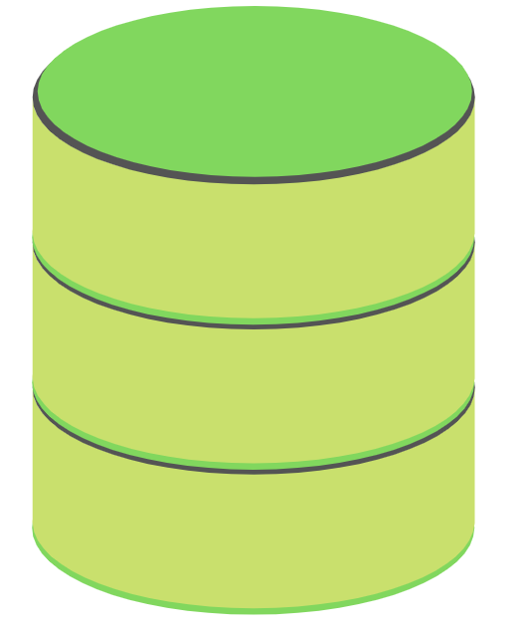
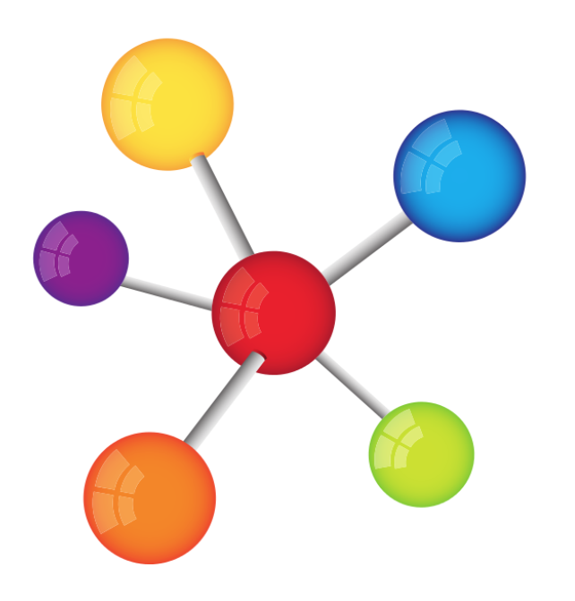
Eventual Consistency
husseinnasser.com
In Database Systems

Slide 2


Eventual Consistency (Tolerable)

Slide 3
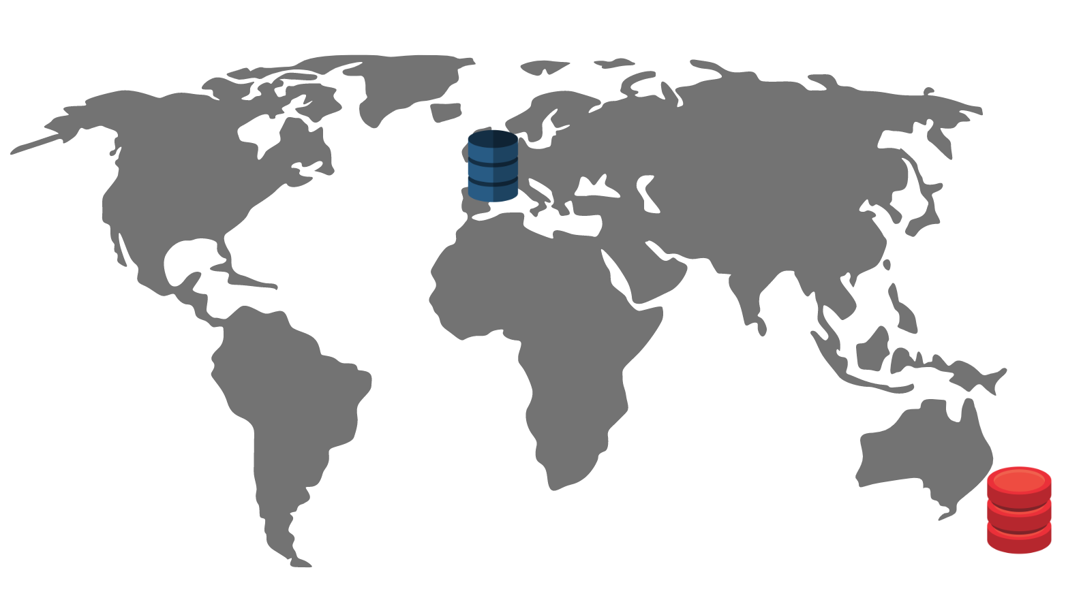
Eventual Consistency (Tolerable)

Slide 4
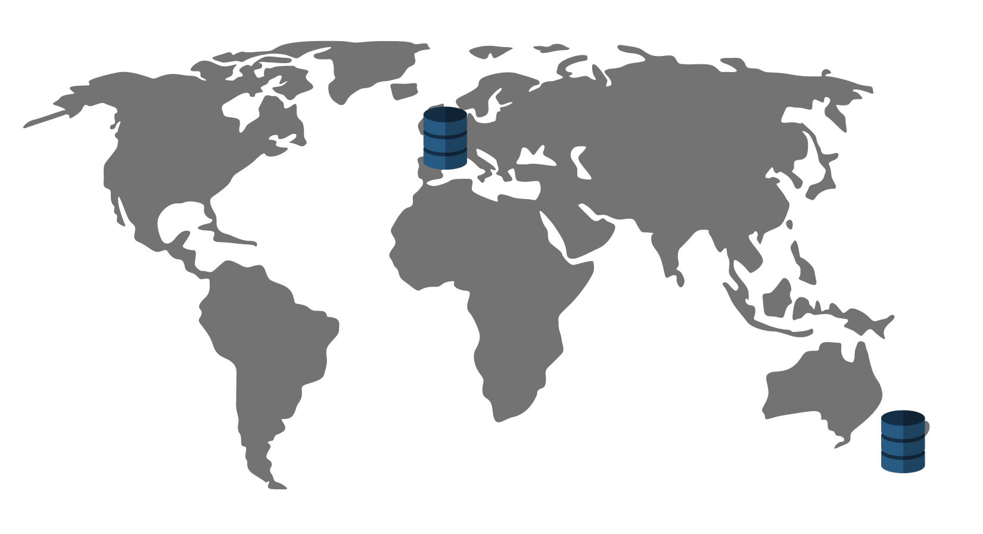
Eventual Consistency (Tolerable)

Slide 5
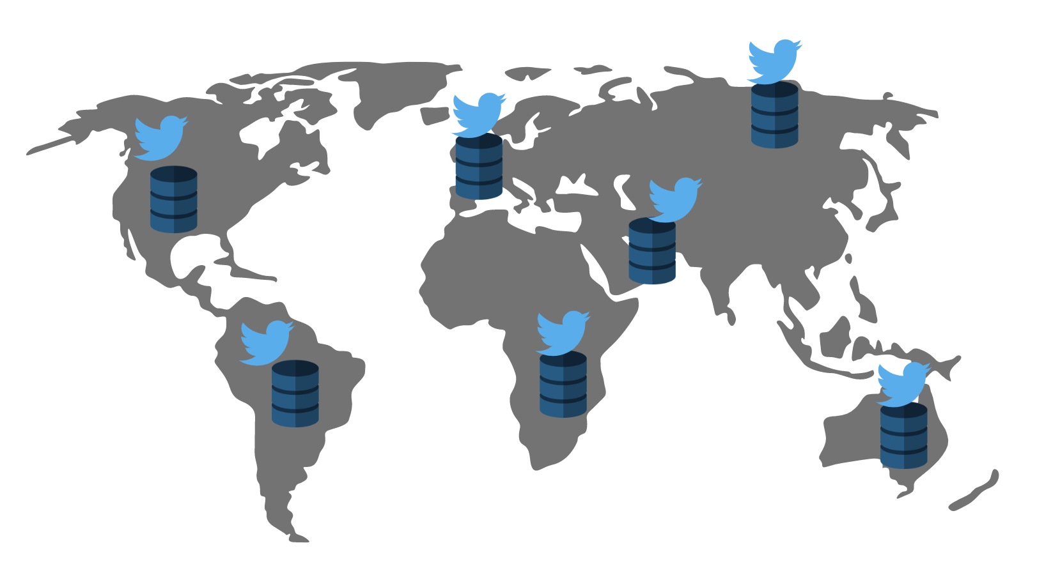

Eventual Consistency (intolerable)

